Slide 1

Timedekhoo
Marketing Project

Slide 2
Group Members Introduction
Muhammad Hamza Ali (20B-008-CS)
Ilhan Ahmed (20B-055-CS)
Shammas Qazi
(20B-080-CS)

Slide 3

Introduction
Brief Overview:
Timedekhoo, your gateway to affordable luxury replicas.
Bringing elegance within reach, we specialize in high-quality replica watches.
Empowering individuals to embrace their style without compromise.
Mission:
At Timedekhoo, our mission is to redefine luxury, making it accessible to everyone.
We believe in providing exquisite replicas that reflect sophistication and craftsmanship.
Striving to create a community where style meets affordability.
Logo and Tagline:
Showcase the Timedekhoo logo, embodying our commitment to quality and style.
Tagline: “Unveiling Moments, Defining Style."

Slide 4


Business Overview
Brand Name:
TimeDekhoo - Simple, memorable, and resonates with South Asian culture.
Company Type:
An LLC is registered for managerial flexibility and personal asset protection.
Domain Name:
"TimeDekhoo" was picked for SEO optimisation, optimal length, and business relevance.
Value Proposition:
TimeDekhoo provides a handpicked collection of high-quality, exotic, and one-of-a-kind replica watches at reasonable costs. Those who desire to stand out with elegance and sophistication are catered to.
Mission:
To introduce the fascination of luxury watches to people on a tight budget by making high-end timepieces more accessible and cheap.
Vision:
To become Pakistan's largest and most trusted replica watch provider, focusing on uniqueness, quality, and affordability.

Slide 5
Cont’d
Personnel:
Ilhan Ahmed and Muhamad Hamza Ali the CEO’s of TimeDekhoo
Customer service and logistics representative will be Hired
Ilhan Ahmed Copywriter
Muhammad Hamza Ali PR/Social media specialist
Shammas Qazi SEO manager
Muhammad Hamza Ali Advertising manager

Slide 6
Competitive Market Analysis
Market Segment:
Individuals and luxury watch enthusiasts with limited budgets who can wear replica watches
Luxury watch collectors are those who have a limited budget but want to maintain the collection just like the original watch collection.
Style Conscious Generation Z
Young professionals who want to get a sleek and premium watch within a budget.
Niche Focus:
Geographic Focus: Exclusive operations in Pakistan
Affordability and Quality
Fashion and Style

Slide 7
Cont’d
Target Market:
Males aged 18 to 45, including tech enthusiasts, students, and young professionals.
Relevant to Pakistan's youthful population interested in fashion.
Unique Selling Proposition: One-week refundable and exchange policy, building trust and confidence.

Slide 8
Competitive Analysis
Competitors:
Ghariyal.pk and The Time Square Watches Co.
Industry Report:
Time Square leading in the replica market with a vast collection.
Ghariyal.pk has a stronger online presence.
Price range: Ghariyal.pk (15k-50k), Time Square (10k-100k+).
Shopping Insights: Rolex, Hublot replicas popular; G-Shock replicas less sold.
Customer Budget: 3k to 15k, with special customers opting for higher ranges.
Repeat Orders: Customers make repeat purchases, indicating market loyalty.

Slide 9
Product Specifications
Detailed Sketches:
Artistic representations of each replica watch design.
Illustrations capturing the intricate details and style.
Materials and Key Features:
Specifications of materials used in production.
Highlight key features such as precision, water-resistance, and unique design elements.
Quality Assurance:
Assurance of top-notch quality through rigorous testing.
Emphasis on delivering watches that meet industry standards.

Slide 10
Pricing and Costing
Target Price:
Competitive pricing based on market analysis and value proposition.
Ensures accessibility to a wide customer base.
Supplier Cost of Product:
Negotiated cost-effective deals with trusted suppliers.
Quality materials sourced at favorable rates.
Total Cost per Unit:
Sum of supplier costs, shipping, and packaging.
Transparent breakdown for customer trust.
Profit Margin per Unit:
Adjusted based on market demand and competition.
Balancing profitability with affordability.
Profit Margins by Price Range:
For Watches Range (1000 PKR to 5000 PKR): Profit Margin: 500 to 1000 PKR per unit.
For Higher-Priced Watches (50000 PKR): Profit Margin: 5000 PKR per unit.
Cost per Unit:
Transparent calculation covering supplier costs and additional expenses.

Slide 11
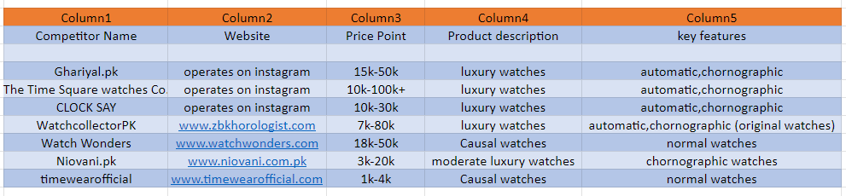
Marketing Research
Among these competitors, some supply luxury watches while others give casual watches, some have a refundable policy while others do not, and their price range varies; some are affordable while others are not. So, there is no unique offering gap in this industry, but what we offer is appealing to clients because we offer a large choice of luxury timepieces at cheap costs and with a refundable policy.

Slide 12
Marketing Strategy
Target Audience:
Ages 20 to 35, urban/suburban areas, middle to upper-class income (50,000 to 100,000 PKR).
Fashion-forward, tech-savvy, and value-conscious consumers.
Channels for Audience Engagement:
Organic Social Media:
Active presence on Facebook, Instagram, and other platforms.
Engaging content tailored to the target audience.
Search Engine Optimization (SEO):
Strategic use of keywords to enhance online visibility.
Content optimization for search engine rankings.
Content Marketing:
Creating compelling articles and visuals to showcase the brand story.
Aligning content with audience interests and preferences.
Influencer Marketing:
Collaborating with influencers to expand reach and credibility.
Leveraging influencers' social media platforms for product endorsements.
Marketing Budget Allocation:
Predominantly focused on content creation and influencer partnerships.
Allocation based on maximizing organic reach and engagement.
Calculated as a percentage of projected revenue.
Assuming a 10% allocation for marketing activities

Slide 13
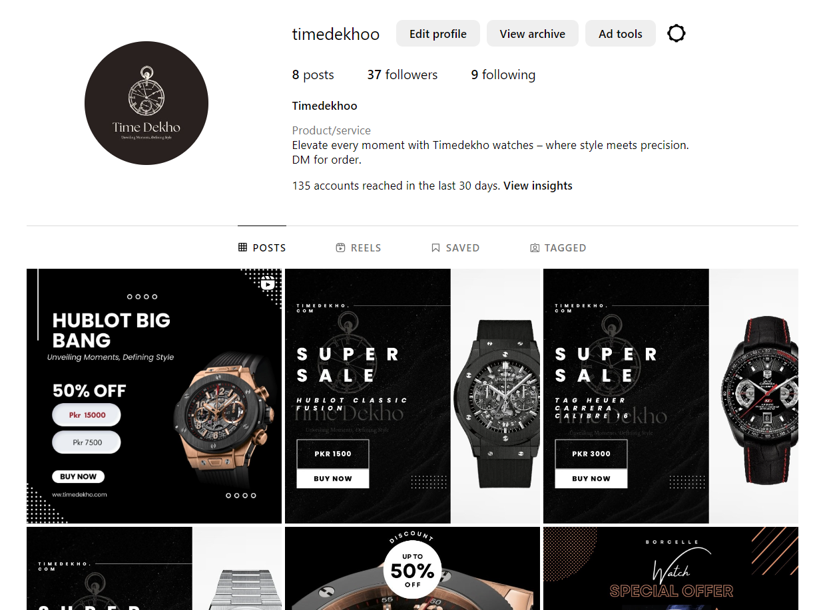
Social Media Presence
Instagram

Slide 14
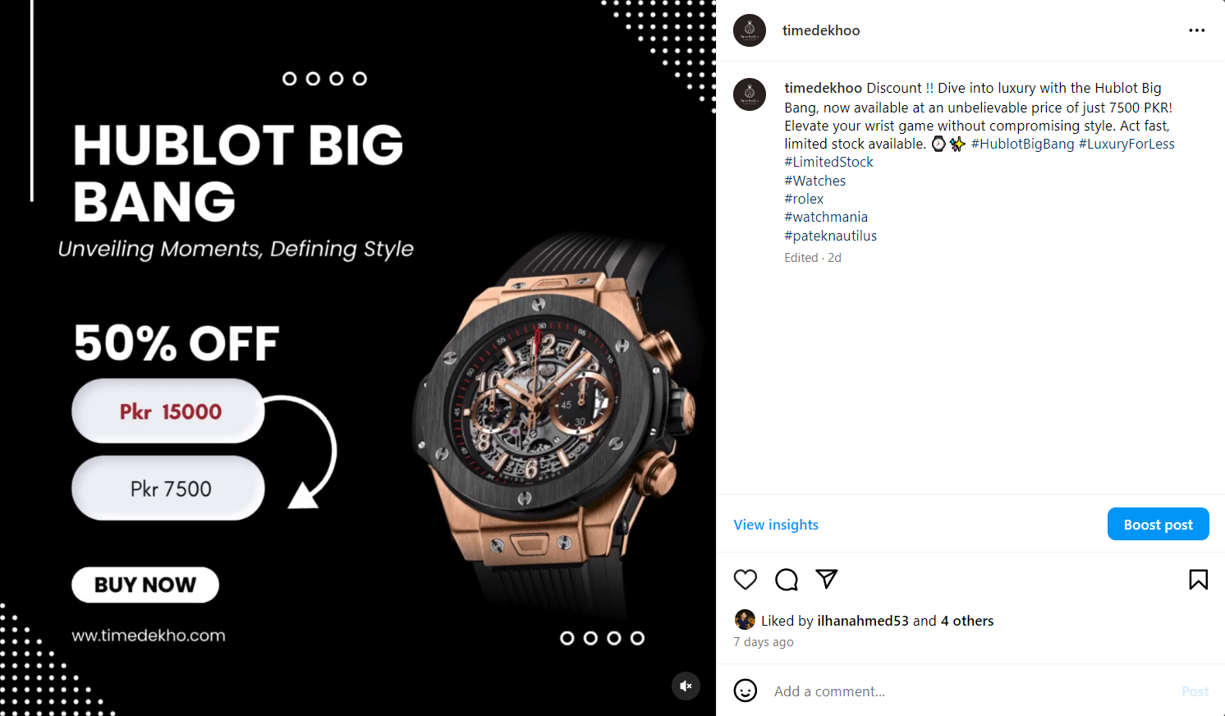
Social Media Presence
Instagram

Slide 15
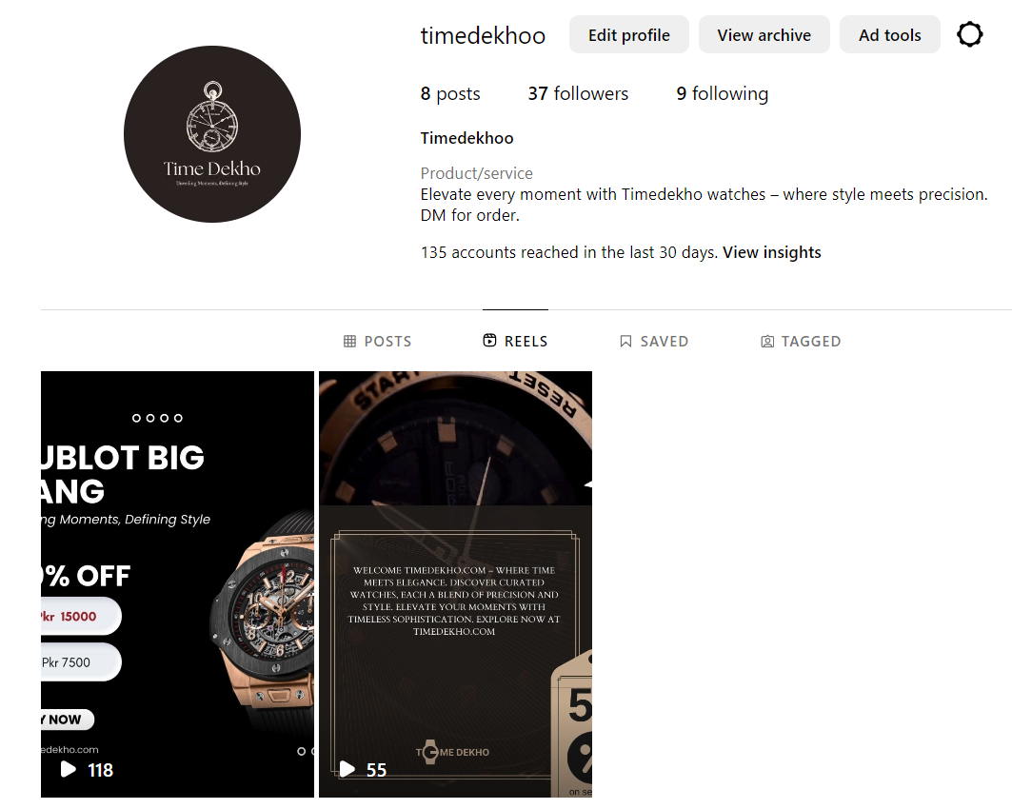
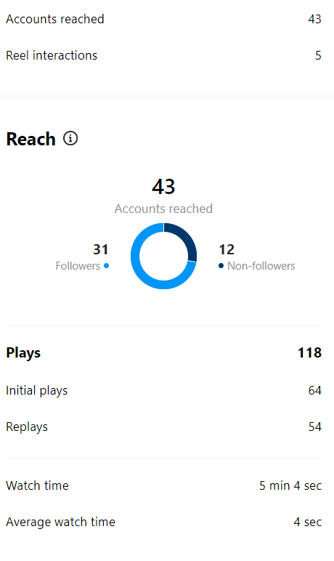
Social Media Presence
Instagram

Slide 16
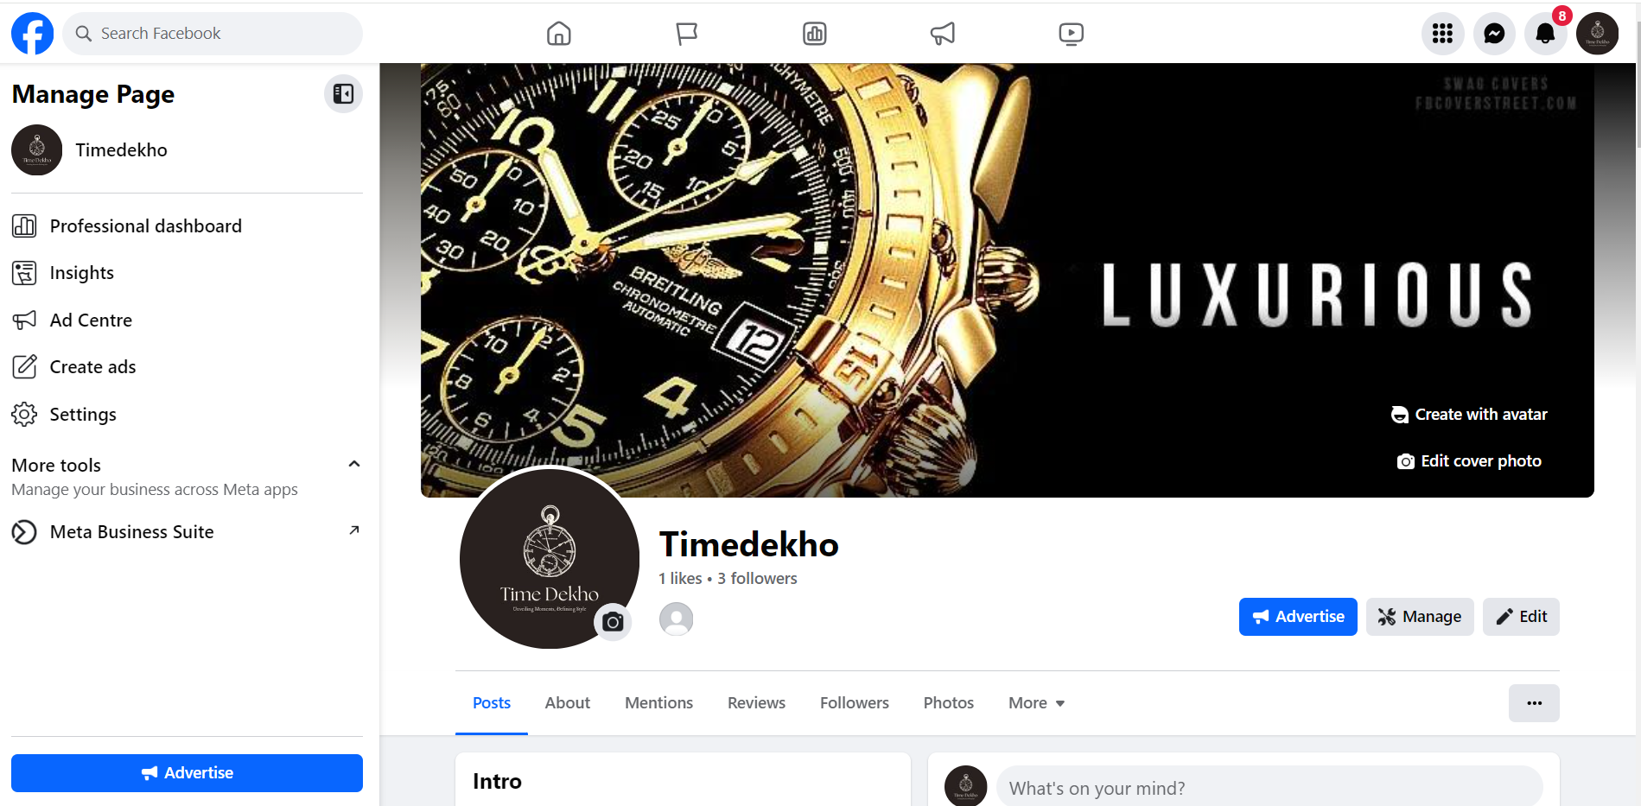
Social Media Presence
facebook

Slide 17
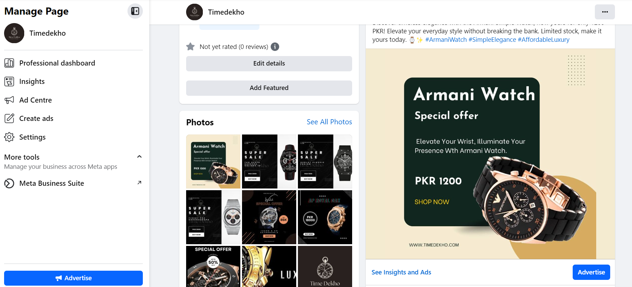
Social Media Presence
facebook

Slide 18
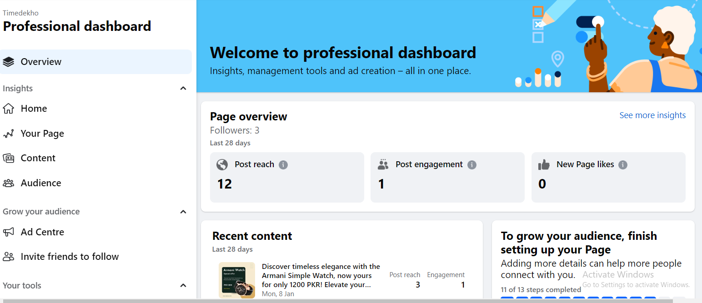
Analytics and Insights

Slide 19
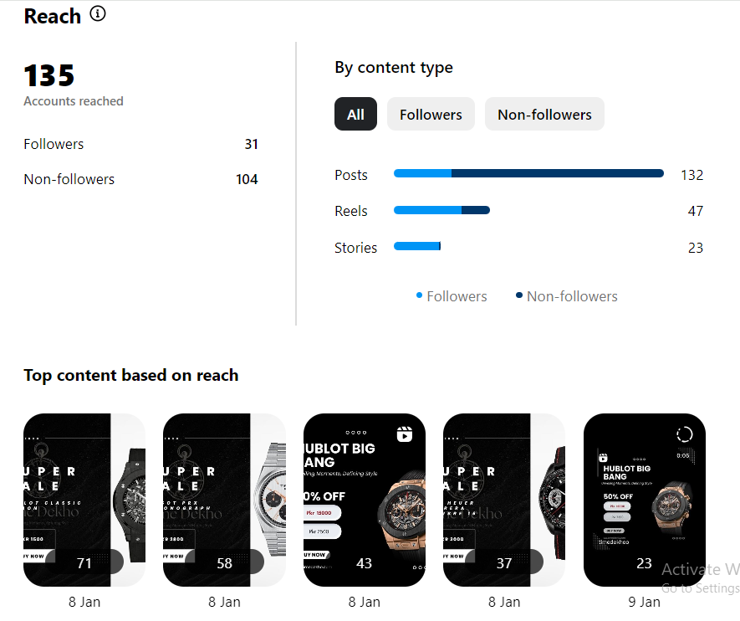
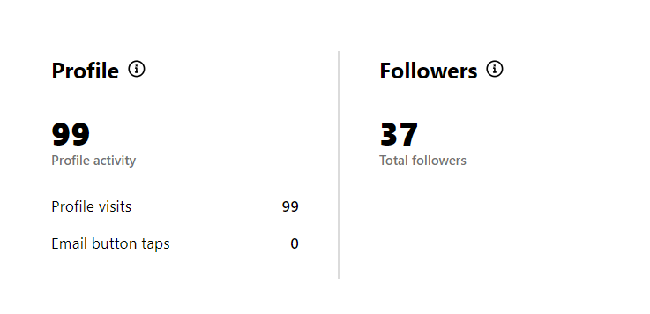
Analytics and Insights

Slide 20
Customer Reviews
Average Customer Rating:
Showcase overall satisfaction ratings ( 4.8/5).
Highlight positive feedback received on product quality and service
Screenshots of Social Media Reviews:

Slide 21
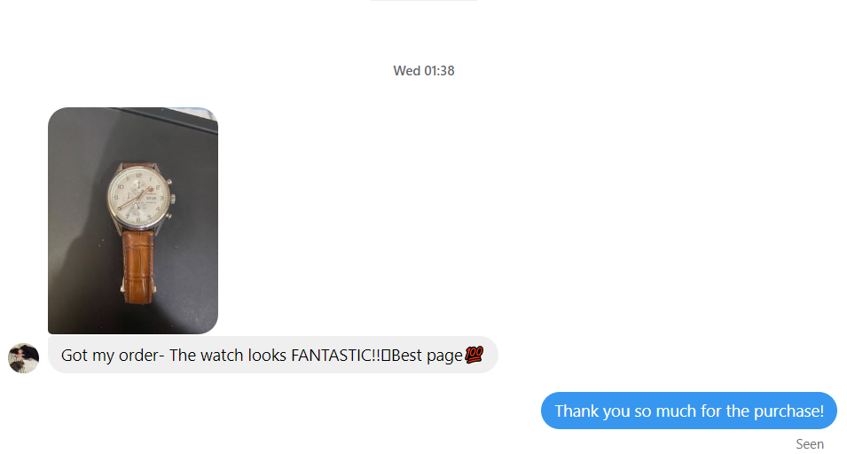
Customer Reviews and Sales

Slide 22
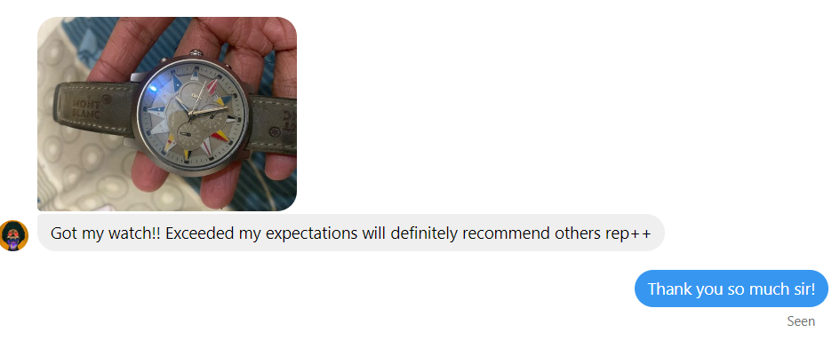
Customer Reviews and Sales

Slide 23

Thank You !!

